Slide 1
The City of Sodaville
Incorporated November 1880

Slide 2
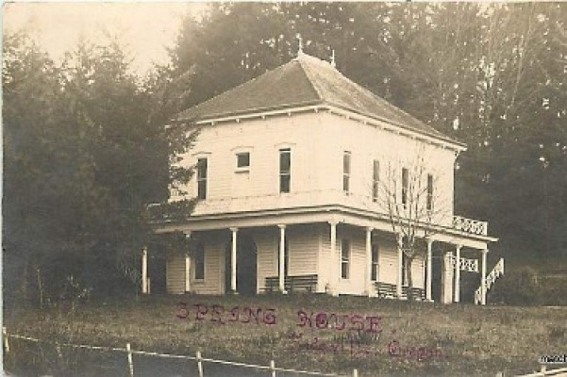
The History

Slide 3
In one of the most picturesque settings on the western slope of the Cascade Mountains is the little town of Sodaville where on the hillside overlooking the town and valley is located the famous Sodaville Mineral Springs. Incorporated in 1880, it officially became the City of Sodaville, Linn County, Oregon.

Slide 4
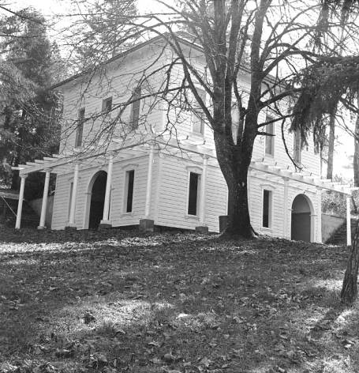
The soda springs were discovered in 1848 by Reuben Coyle. The history of Sodaville centers around the spring of pungent mineral water flowing from a rocky hillside. For many years, the water from the spring was highly regarded for its medicinal purposes. People came from as far as Canada to collect or bathe in the soda water.

Slide 5
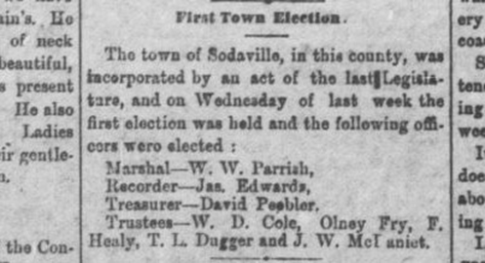
Sodaville arose due to Rueben Coyle who took up a land claim in the area in 1847. He discovered the mineral spring one day while searching for stray oxen. With Coyle in 1847 had arrived William Klum and Richard Usher. Other early settlers in the area were John Coyle, Caleb Burge, Hiram Klum, W. B. Gibson, Medders Vanderpool and Thomas S. Summers. The spring was on land owned by Thomas Summers, but Philester Lee also claimed it. Litigation lasted 18 years, but on May 4, 1871, full title was given to Mr. Summers. He immediately deeded a lot of 99 feet square to the public so the spring could be enjoyed by all. He also laid out the town of Sodaville, which was incorporated Nov. 8, 1880. Below is an article from the December 3, 1880 State Rights Newspaper.

Slide 6
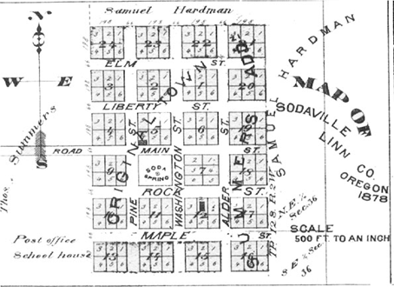
The original intent was to incorporate earlier on and compete with the cities of Salem, Portland, Corvallis and Oregon City for State Capital, there was a land dispute (that was later settled by the Supreme Court) and Congress in Washington D.C. named Salem the capital. The dispute continued for 18 years, dividing the community into factions and stirring up feuds between neighbors. Summers was given the final decision by the Supreme Court in 1867 and received his patent from the government. Though the long-drawn-out litigation had cost him everything he owned, Summers remained true to the principle that had kept him fighting all those years. Believing that Nature’s special gifts are not intended for private exploitation he deeded block eight in the town of Sodaville, with the spring in the center, to the public, May 4, 1871. 1880. The original town plat contained twelve blocks; later Summers Addition added an additional twelve blocks.
Notes:
The State rights democrat. (Albany, Or.), December 03, 1880

Slide 7
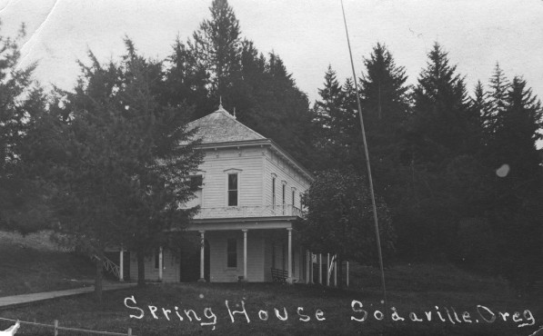
SPRING PRESERVATION
The movement to preserve the spring came first from the pioneers themselves. They built a rail pen around it. This kept the cattle out but not the deer. Then the rails were replaced by a board fence. Later a local man built an open shed over the spring, octagonal in shape, with seats around the inside. The floor was brick and the water was dipped from bricked-up shallow wells. Milton A. Miller secured the first help from the state, an appropriation by the legislature for improvements in 1891, and the building was put up, though not completed until ten years later. More money for repairs and improvements was secured in 1901 and 1920. The legislature in 1947 turned the property over to the state highway commission and the department of state parks.
Mineral Springs Park was deeded to the City of Sodaville in 1972.

Slide 8
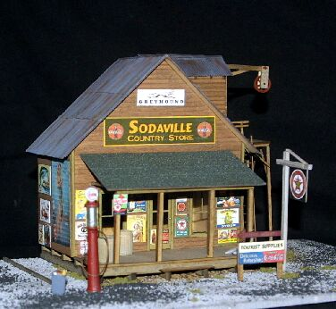
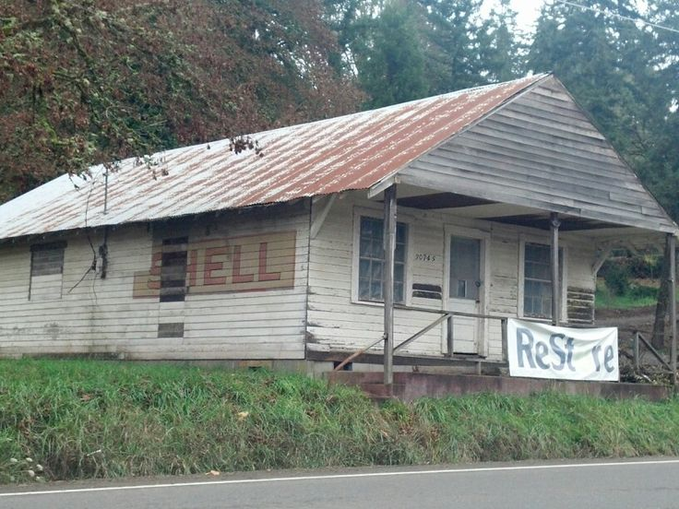
The city reached its height in the 1800’s boasting 5 hotels, livery stables, Perry Drug Store, a skating rink, a jail, bath houses, a general store, post office, meat market, barber, cobbler, blacksmith,

Slide 9
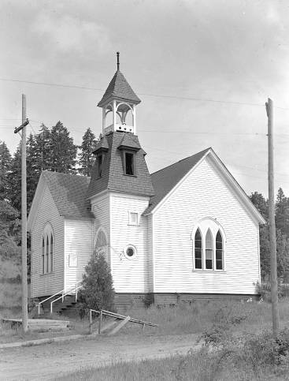
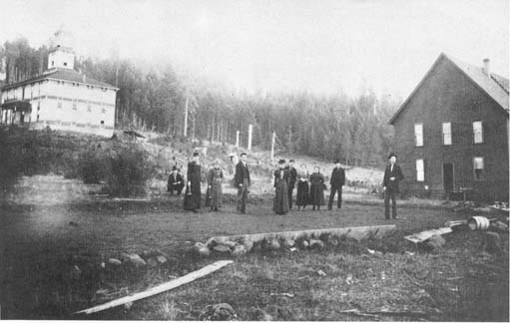
daily stagecoach, weekly paper, doctor, telegraph office, 3 churches, furniture factory, sawmill, the Sodaville Railroad Company, and the Mineral Springs (Seminary) College that was founded in 1892.

Slide 10
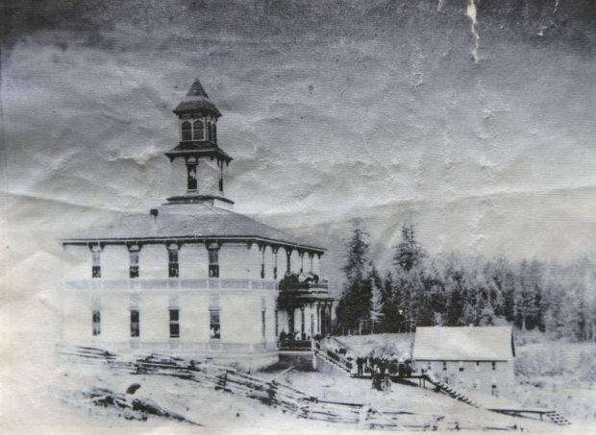
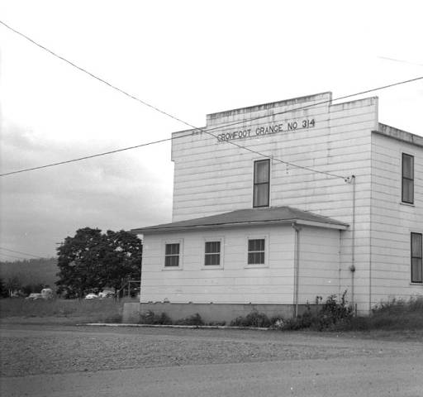
Mineral Springs College, which played such an important part in the history of Sodaville, started as a seminary founded by Louis Barzee and his brother Charlie. The former first came to Sodaville as a teacher in the public school, and decided that the place was ideal for a seminary because of its reputation as a resort, the beauty of the surroundings and the fact that land could be secured by donation. The brothers raised the money to build in 1892. The current Crowfoot Grange was once the college dormitory.

Slide 11
Hotel Fires
One night in May 1893, fire stated in the Hardman hotel on the northwest corner of the block. It spread to a 64 by 64 hall in the center of the block and then to the 23-year-old Carmichael hotel on the south corner. By the time the fire was out, much of Sodaville had burned.
J.P. Chesshire built another hotel on the southwest corner and the band built its hall in 1896 on the site of the old hall. When that hotel burned in 1907 the band hall was saved only by most strenuous efforts. Fire took the hall, however, in 1929.

Slide 12
Spring Water
Water, in the form of a mineral spring, was the making of the town. Lack of water, in adequate supply, was its undoing. Fire has taken an awful toll in these 100 years. Though the Sodaville hillside has many fresh water springs most of them, as well as the old dug wells, succumb to the summer’s drought. It is proverbial of the place that “once a house gets afire it’s a goner.” On the block on which now is located the Sodaville store, which might be designated as the town’s main business block, there have burned three hotels, two halls with stores on the first floor, a small store and five or six houses. Throughout the village houses have burned by the dozens.

Slide 13
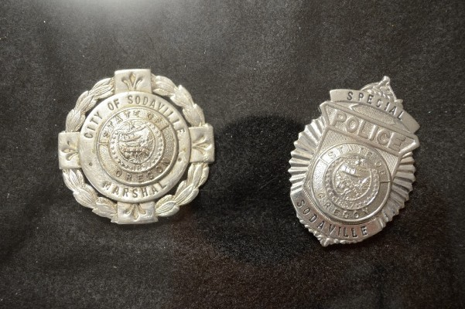
By about 1910 the town had become so peaceful and sleepy that a blind man, George Price, was elected city marshal and served with distinction

Slide 14
INDIAN CEMETARY
The claims of William Klum and his son George W. Klum were over the hill, east of the spring. George Klum was an early office holder, serving on the board of the first election held in Lebanon in 1848. Henry Klum, younger half brother of George, and a veteran of the Indian wars, who died in Lebanon, told of the Indians who were numerous in the early days. There was an Indian burial place on his father’s claim. He recalled hearing the wailing and mourning of the approaching burial trains when they were still miles away. The Klums respected this cemetery, never disturbing the articles placed on the graves, -- beads by the bucketful, dishes, arrows and guns. In later years, Henry and his nephew, Hiram Klum, each tried to find the location of these graves, but could not. Changes in trails, roads and fences and growth of underbrush and timber had completely obliterated old landmarks.

Slide 15
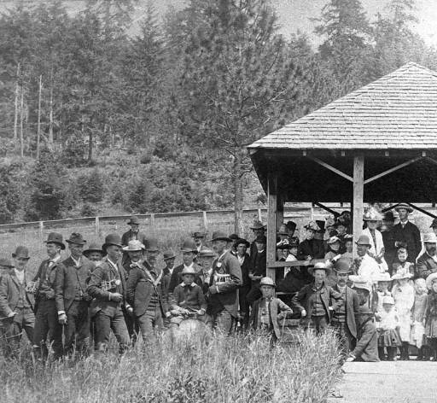
Concert Band
The Sodaville Concert Band, organized in 1891, maintained a membership of 10 to 12, and was well known through out the county, having playing engagements at Albany, Lebanon, Brownsville, Corvallis, Scio and Newport. It was a success financially as well as musically. Incorporated in 1895 it built a hall in which to hold concerts with accommodations for a general store on the ground floor. The band made its last public appearance at the graduation exercise of the college June 1898, but remained an active organization until the property was sold in 1910.

Slide 16
The past to the present
The town started as a group of pioneer cabins clustered around the spring. It reached its height in the early 1890’s as a resort, so popular that hotels were filled to capacity every summer. Camping places were at a premium. There was a college with an enrollment of over 100.
Then the popularity of the water declined. Changes in transportation made more distant resorts not as accessible. The college closed. Fire destroyed many buildings. Sodaville became a ghost town with deserted streets and empty houses.
But the spring is still there, and, because of it, a spark of community loyalty. The City began to grow again, this time as a very tightly knit community of pleasant homes, 2 churches and the Sand Ridge Charter School. There are 2 parks, the original Mineral Springs park that is also the location of City Hall and the new Soda Springs Community Center Park that now has a Multi Use Sport Court and is in the process of being developed along with a future home of a Community Center/City Hall. The current population is about 340 and is still growing. There has been an increased interest in living in the small town atmosphere. Close to amenities available in the cities of Lebanon and Sweet Home, the large lots, wildlife, and surrounding forest, means the City of Sodaville’s population is increasing.

Slide 17
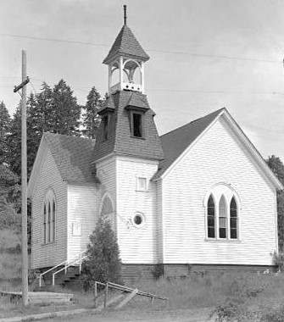
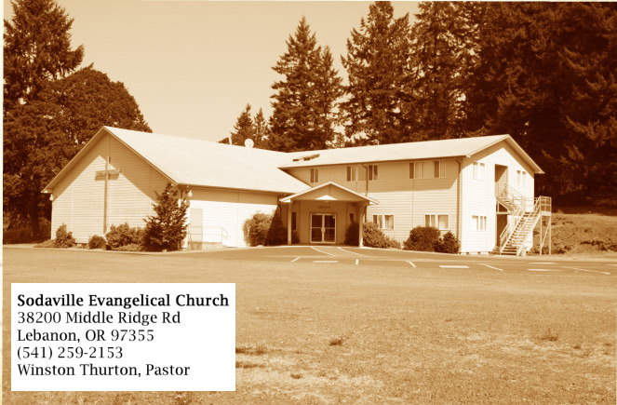
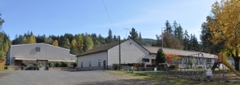
Grace Bible Fellowship
30699 Spring Street
Lebanon OR 97355
Sand Ridge Charter School
30581 Sodaville Mountain Home Road
Lebanon, OR 97355

Slide 18
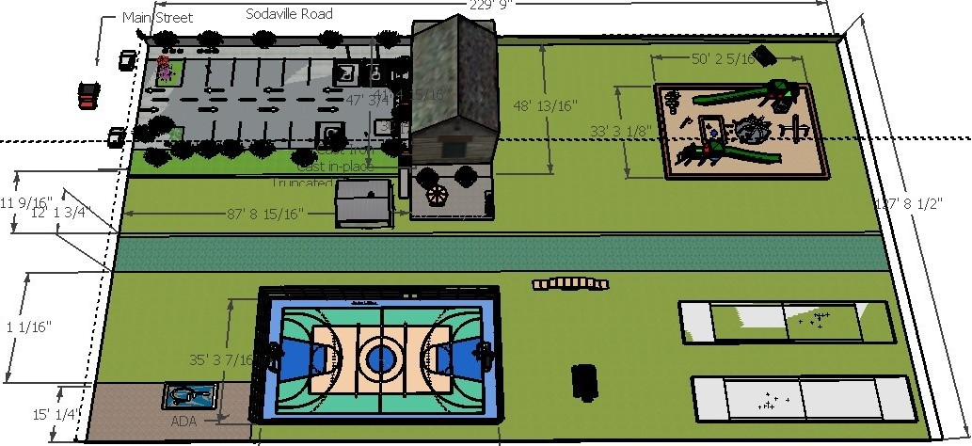

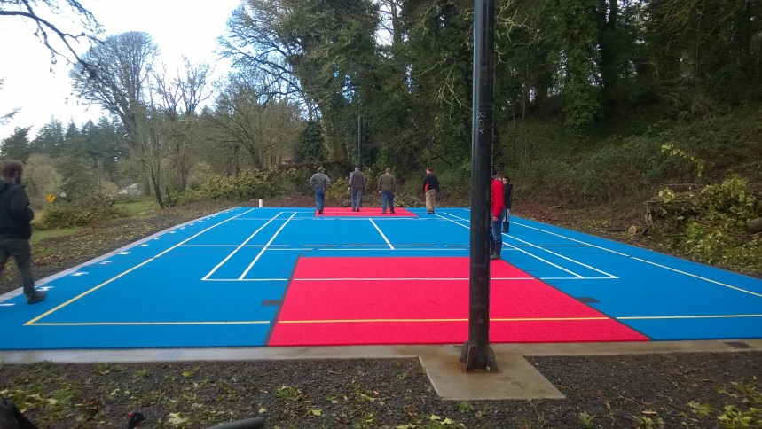
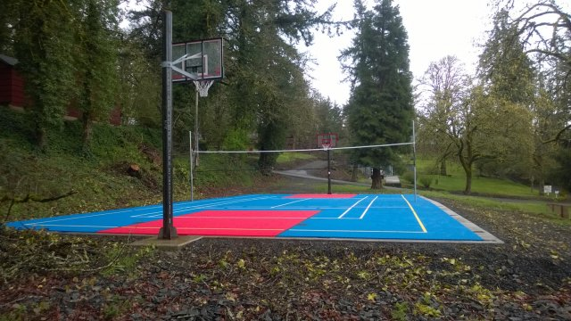

Slide 19

City of sodaville
Email: Sodaville@cityofsodaville.org Web Page: www.sodaville.org
Phone & Fax: 541-258-8882
30723 Sodaville Road, Lebanon, Oregon 97355

